Slide 1


Airline Safety

Slide 2
Reasons Flights are Safe to Travel
High Safety Standards and regulations that cover everything from aircraft design and maintenance to pilot training and operational procedures.
Advanced Technology with robust structural integrity that makes the airplanes highly reliable, and backup systems and protocols to handle any emergencies.
Security measures such as passenger screening, baggage checks, and security personnel to handle potential threats.
Continuous monitoring and maintenance checks involving every component inspection and replacement in a strict schedule.
Statistics consistently show that air travel is much safer compared to other modes of transportation.

Slide 3
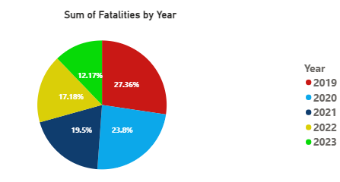
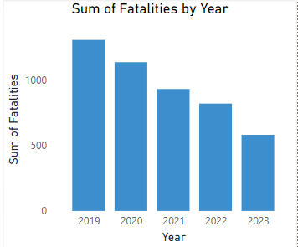
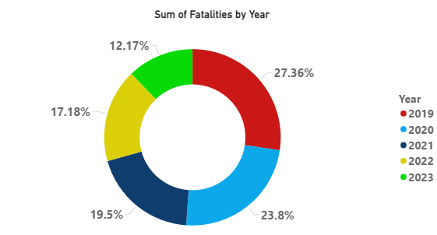
Statistics on Flight Safety
The above Bar graph shows that the number of fatalities was more than 1300 and has been decreasing over the years to less than 500.
The above Bar graph shows that the number of fatalities was more than 1300 and has been decreasing over the years to less than 500.

Slide 4
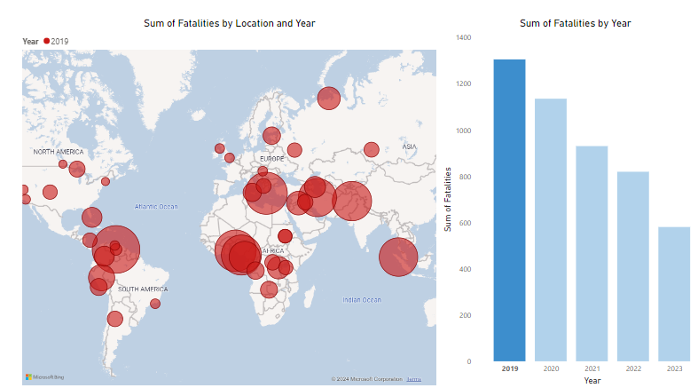
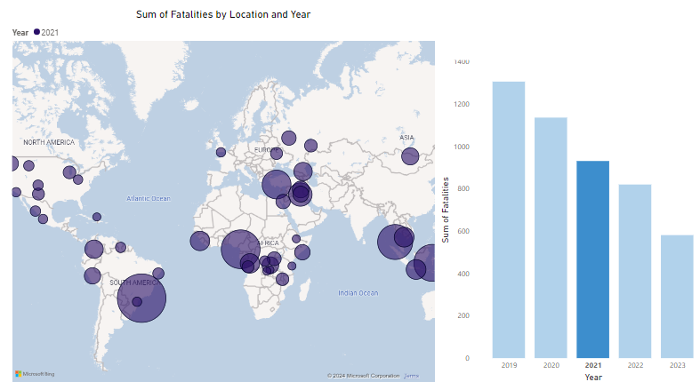
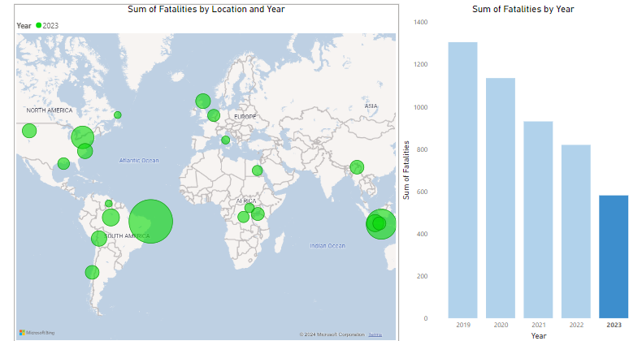
The sum of Fatalities by Location and Year
The above Bar graph shows that the number of fatalities was more than 1300 and has been decreasing over the years to less than 500.
The above Bar graph shows that the number of fatalities was more than 1300 and has been decreasing over the years to less than 500.

Slide 5
Conclusion
Flying is an incredibly safe way to travel, thanks to advanced technology, rigorous training, stringent regulations, and a proactive approach to safety and security. Next time you book a flight, you can rest assured that your safety is our top priority.

